Slide 1
CLASS 2
Dated 8 th JANUARY , 2025
Course Title: 5G and Wireless Technology
Course Code : ECE829
Introduction to 5G Communication Signals & System
Prof.(Dr.) Rabindranath Bera (Professor, IIIT, KALYANI)
E-mail: rbera@iiitkalyani.ac.in; Mobile : 9475513358

Slide 2

5G IOT Use Cases in addition to 5G SMARTPHONE is Progressing at Lighting Speed as shown below:-

Slide 3
OUR MOTIVATION
ISSUES and SOLUTIONS in 5G COMMUNICATION SYSTEM
Solution towards COVERAGE :
3D TN_NTN CONVERGENCE COMMUNICATION in 6G ERA
[ TN ... Terrestrail Network, NTN .... Non Terrestrail Network Including Satellite ]
Upgradation of 6G Network having 3D COMM ( TN-NTN)
TN CELL ... GREEN and SMALL Circle
SATELLITE NTN CELL ... BLUE and LARGE Circle
Upgradation of UE ( USER EQUIPMENT ) ..6G Mobile
6G TN (UE) can have both TN and NTN Capability
in TN Coverrage area , it will operate as TN UE
in Other Areas, It will operate as NTN UE

Slide 4
Outline of Presentation
5G TEST BED at IIIT KALYANI
DEMO 1 of 5G LAB SET UP AT IIIT KALYANI at ROOM NO G 05
https://drive.google.com/file/d/1mB3v7qXmhT4YCGtggj1umFyQipkE-LyN/view?usp=sharing
Discussion of 5G LAB SET UP AT IIIT KALYANI using 2X2 MIMO Spatial Multiplexed Radio Unit (RU)
SPEEDTEST using a 5G Mobile with POOR Throughput Efficiency due to use of Omni-directional
Antenna Beam ; Maximum Data rate =40 Mbps ( too Poor and Poor Throughput efficiency)
DEMO 2: Discussion on Recent DEMO 2 of 5G by QUALCOMM using MIMO Beamforming
Radio Unit (RU)
DEMO link: https://players.brightcove.net/1414329538001/BJv5wEFt_default/index.html?videoId=6322791358112
Throughput Efficiency =100% due to Laser like Antenna Beam
COMPARE 5G SYSTEM at IIIT KALYANI and QUALCOMM ; Note the difference in ANTENNA
DEMO 3: SYSTEMVUE Software Simulation of MIMO Beamforming Radio Unit (RU)
RADIATION PATTERN
TECHNOLOGY TRENDS towards 5G /6G Mobile Communication
5G UNIFIED and 5G SPLIT Architecture
5G UNIFIED Architecture : 5G NR ( New Radio) DL( Downlink) Throughput
DEMO 4: SISO Case using SYSTEMVUE Software Simulation
DEMO 5: SISO BF Case using SYSTEMVUE Software Simulation
DEMO 6: MIMO 2X2 Case MIMO 2x2 BF Case using SYSTEMVUE Software Simulation
5G SPLIT Architecture

Slide 5
Outline of Presentation
5G TEST BED at IIIT KALYANI
DEMO 1 of 5G LAB SET UP AT IIIT KALYANI at ROOM NO G 05
https://drive.google.com/file/d/1mB3v7qXmhT4YCGtggj1umFyQipkE-LyN/view?usp=sharing
Discussion of 5G LAB SET UP AT IIIT KALYANI using 2X2 MIMO Spatial Multiplexed Radio Unit (RU)
SPEEDTEST using a 5G Mobile with POOR Throughput Efficiency due to use of Omni-directional
Antenna Beam ; Maximum Data rate =40 Mbps ( too Poor and Poor Throughput efficiency)
DEMO 2: Discussion on Recent DEMO 2 of 5G by QUALCOMM using MIMO Beamforming
Radio Unit (RU)
DEMO link: https://players.brightcove.net/1414329538001/BJv5wEFt_default/index.html?videoId=6322791358112
Throughput Efficiency =100% due to Laser like Antenna Beam
COMPARE 5G SYSTEM at IIIT KALYANI and QUALCOMM ; Note the difference in ANTENNA
DEMO 3: SYSTEMVUE Software Simulation of MIMO Beamforming Radio Unit (RU)
RADIATION PATTERN
TECHNOLOGY TRENDS towards 5G /6G Mobile Communication
5G UNIFIED and 5G SPLIT Architecture
5G UNIFIED Architecture : 5G NR ( New Radio) DL( Downlink) Throughput
DEMO 4: SISO Case using SYSTEMVUE Software Simulation
DEMO 5: SISO BF Case using SYSTEMVUE Software Simulation
DEMO 6: MIMO 2X2 Case MIMO 2x2 BF Case using SYSTEMVUE Software Simulation
5G SPLIT Architecture

Slide 6
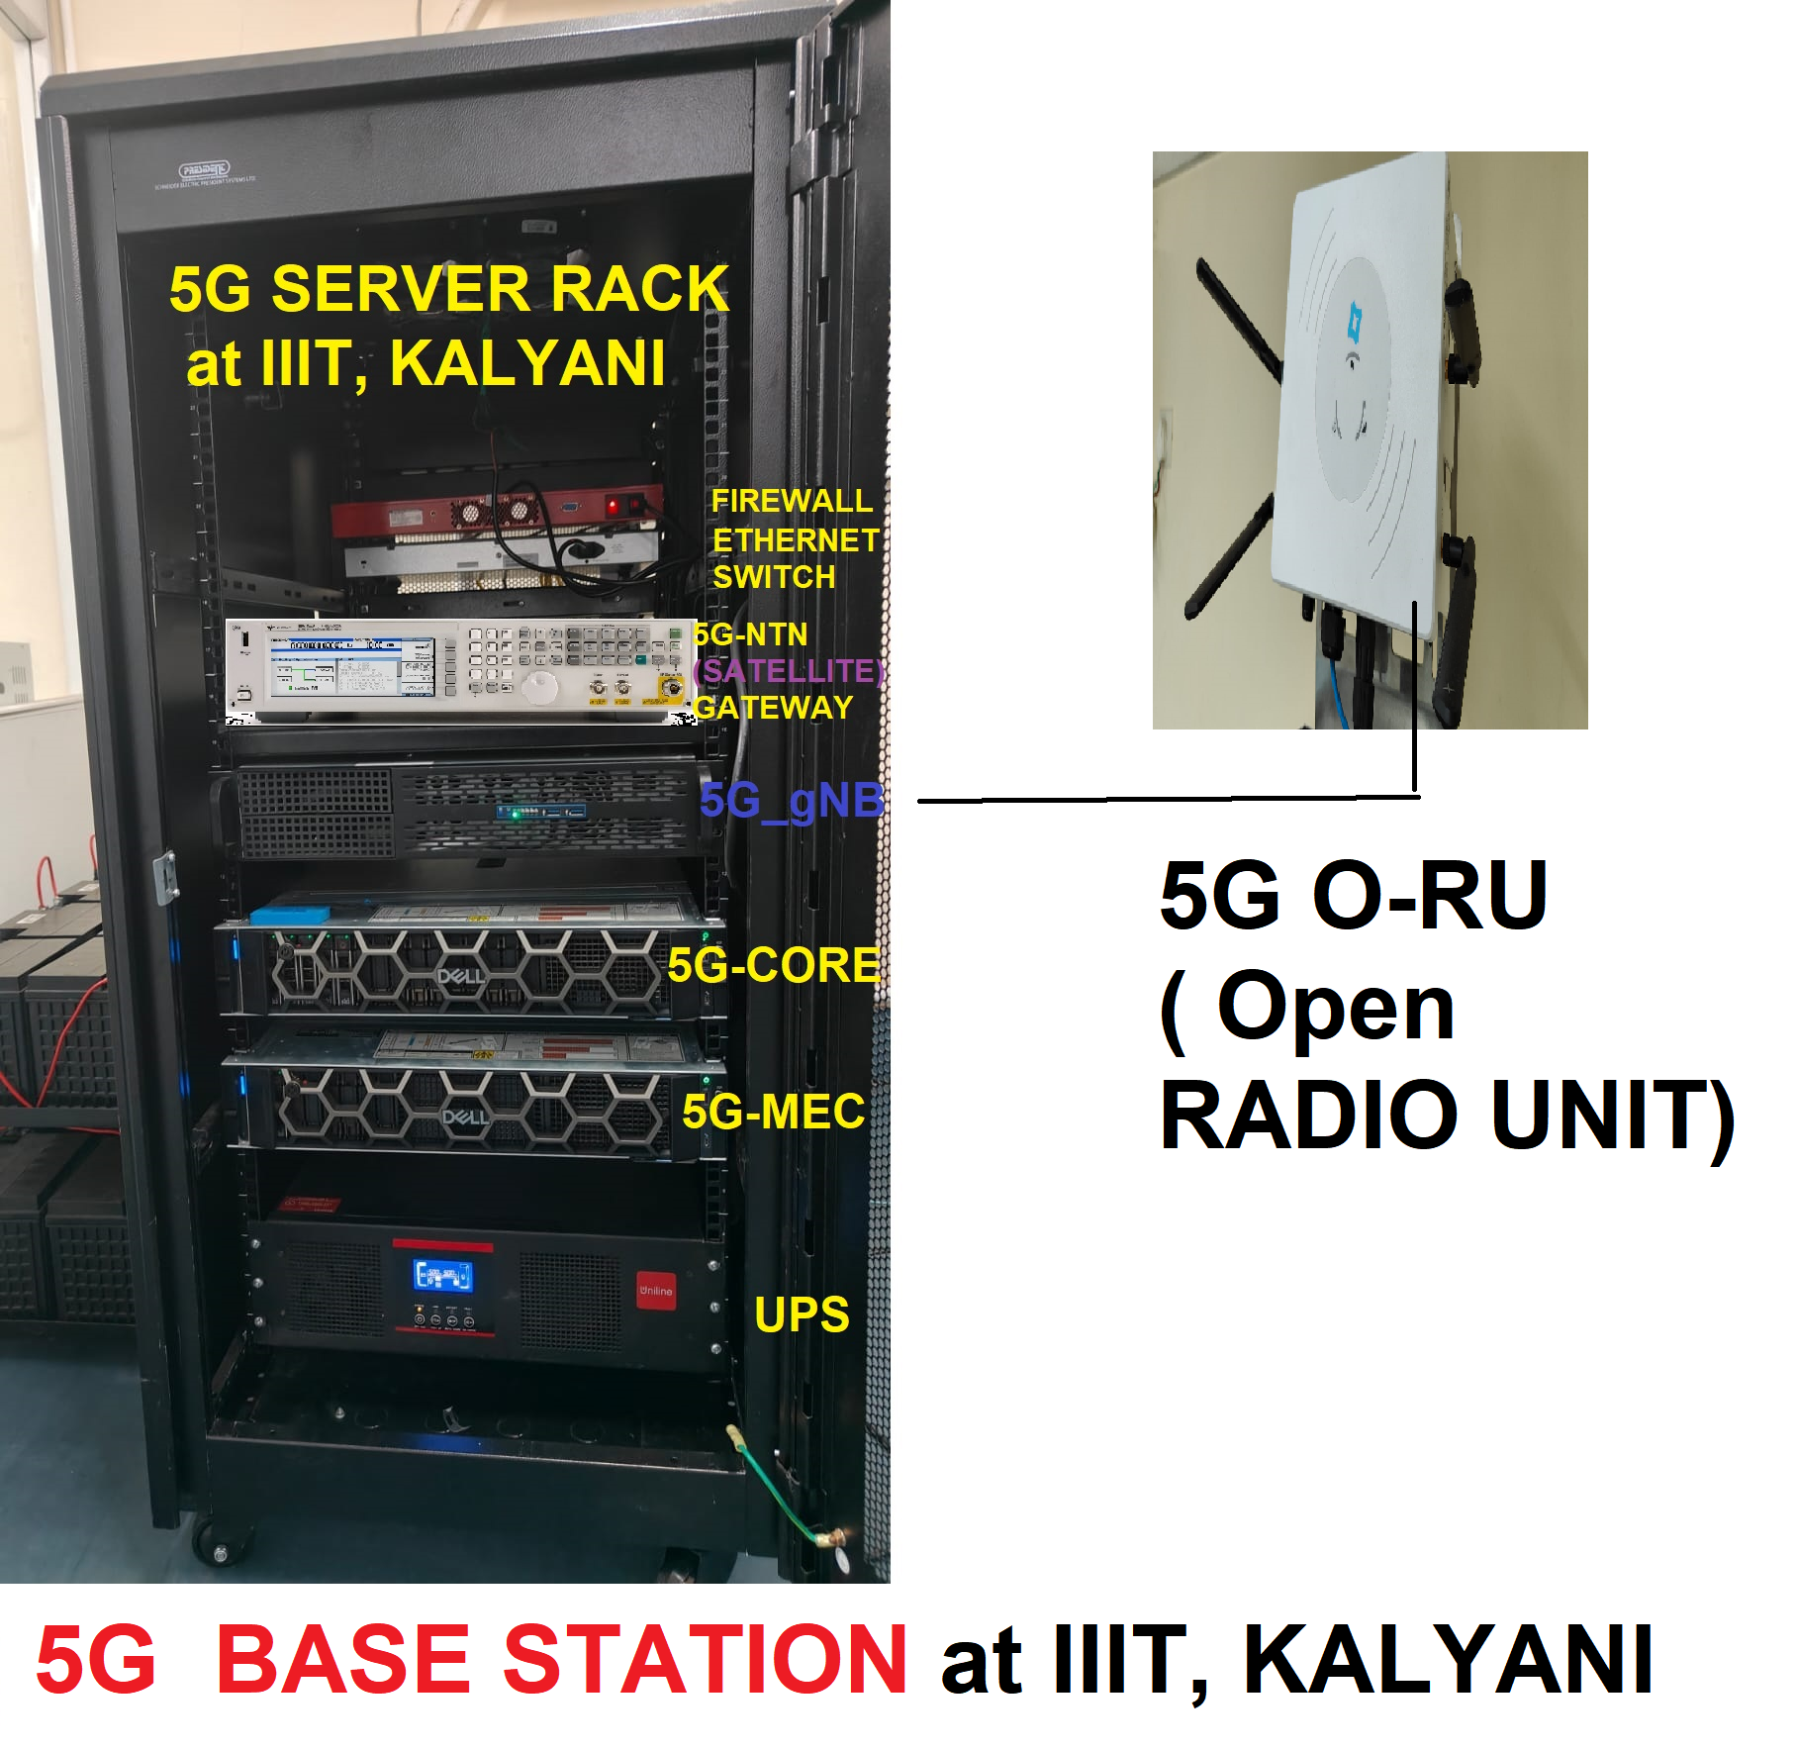
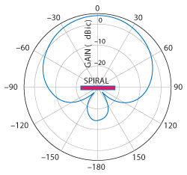
5G LAB SET UP AT IIIT KALYANI using 2X2 MIMO Spatial Multiplexed Radio Unit (RU)
Maximum Data rate =
200 Mbps
** 5G NTN ( Satellite) GATEWAY ... Future ADD-ON
5G SPIRAL ANTENNA
RADIATION PATTERN
OPEN RADIO UNIT ( O-RU) with 4X4 Antenna at 5G Test BED , IIIT KALYANI

Slide 7
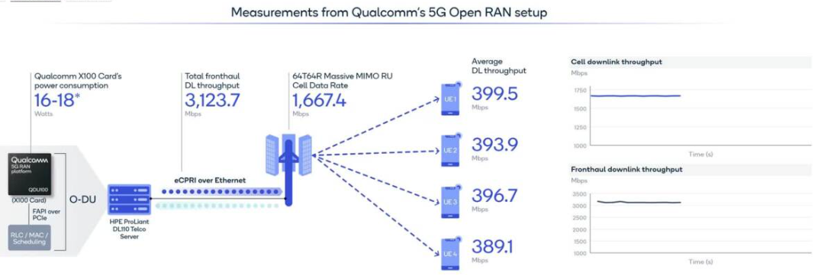
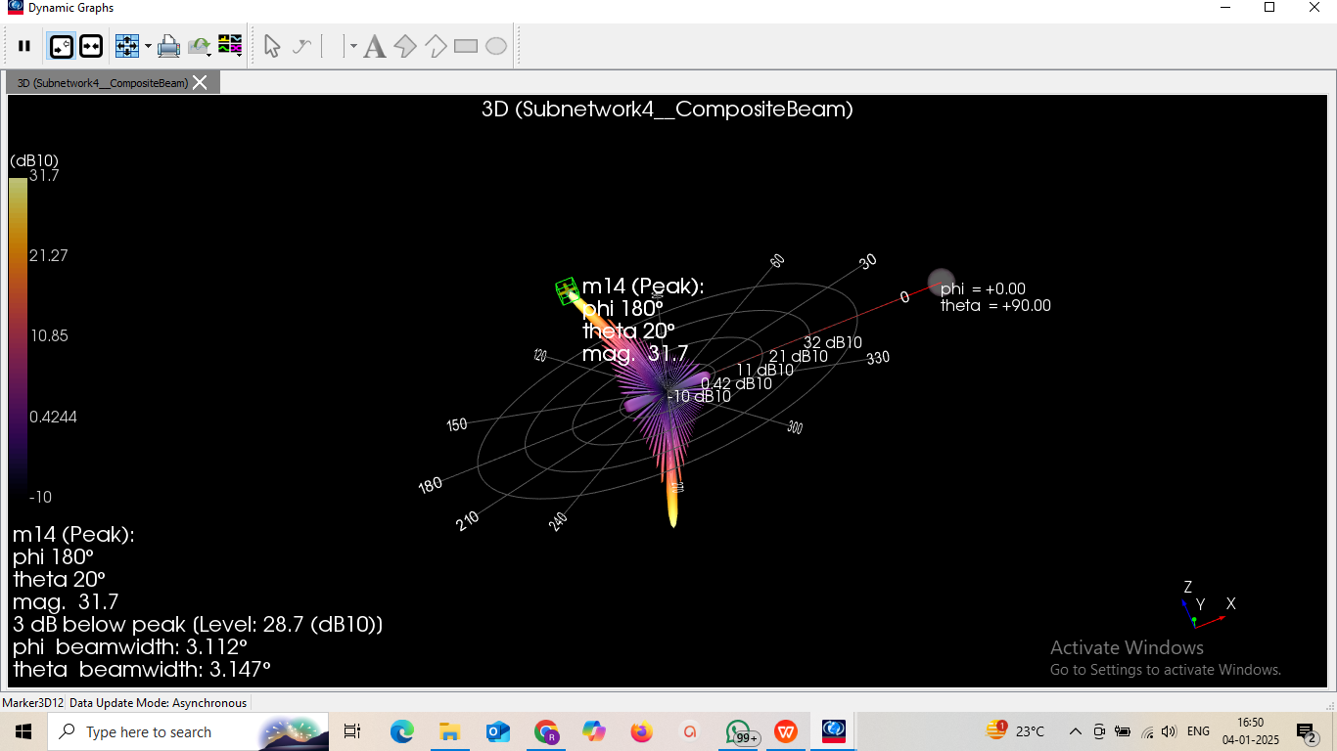
5G LAB SET UP at QUALCOMM, USA using MIMO BEAMFORMING ( MIMO BF) ANTENNA with RU Radio Unit
Maximum Data rate =1667.4 Mbps; Antenna Beamwidth = 3 Degree

Slide 8

5G SPIRAL ANTENNA
RADIATION PATTERN
of 5G Test BED at IIIT, KALYANI
Antenna Beammwidth =
120 Degree
Data Rate = 200 MBps
MIMO Beamforming Radio Unit (RU) RADIATION PATTERN at QUALCOMM
Antenna Beammwidth = 3 degree; Data rate = 1667.4 Mbps

Slide 9
QUALCOMM Open RAN TEST BED

Slide 10
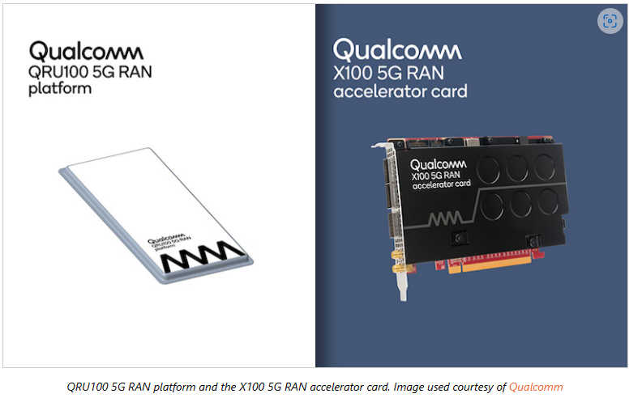
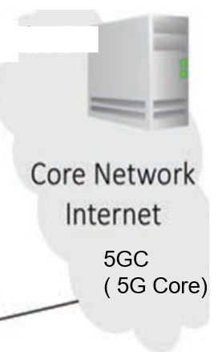
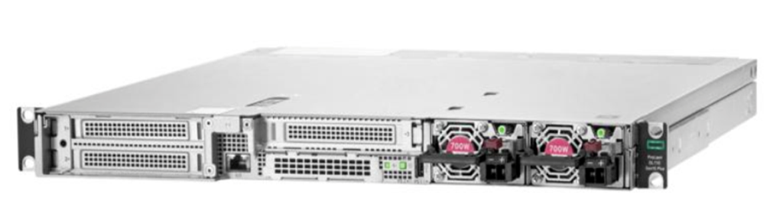

Realization Trends by QUALCOMM :
5G NR-RAN Evolution
NEWS Qualcomm and Vodafone Team for Next-gen 5G O-RAN Effort
November 04, 2022
Qualcomm and Vodafone recently announced that they will collaborate to test and develop infrastructure solutions that will be based on Qualcomm’s Open RAN (O-RAN) devices that are claimed to be energy efficient and high performing: the QRU100 5G RAN Platform, and the X100 5G RAN Accelerator Card. Qualcomm began sampling both cards in Q3 2022.
Vodafone is the leading telecommunications provider in Europe and has publicly committed to improving the environmental sustainability of its networks and brings expertise in large-scale network deployment to the partnership. The company envisions a future network that will support wireless high-bandwidth applications such as virtual and augmented reality.
The two companies plan to unveil more details on their 5G O-RAN infrastructure solution at the World Mobile Conference 2023 in Barcelona.
O_RAN = O_CU + O-DU + O-RU
O_CU:-
HPE ProLiant DL110
Gen10 Plus Telco server
O-DU Card within
PC
O_RU

Slide 11
Outline of Presentation
O-RAN (Nearest Base STATION near Your Mobile ACCESS) POPULARITY with
3.5 GHZ RADIO for 5G
O-RAN OBJECTIVES
Realization Trends by QUALCOMM … THE DEMO of O-RAN
Realization Trends by REBECA -LEKHA… INDIAN ATTEMPTS
Realization Trends by BTI Wireless
Realization Trends by VVDN Technologies… Indian Attempts [already with IIIT Kalyani (DOT FACILITIES ) ]
Realization from O-RAN to B-RAN for Network Wireless Security ; [B … BLOCKCHAIN ]
REALIZATION of O-RAN/B-RAN ARCHITECTURE at IIIT KALYANI with 5G USE CASE LAB SPONSORED BY DOT
Problem Definition, Assumption and Objectives of 5G/6G Research Works at IIIT, KALYANI
PICTORIAL REPRESENTATION of the OBJECTIVES OF IIIT, KALYANI
Deliverables from 5G/6G Research Works at IIIT, Kalyani
PICTORIAL REPRESENTATION of the HARDWARE DELIVERABLES
SOFTWARE SIMULATION DELIVERABLES
** https://players.brightcove.net/1414329538001/BJv5wEFt_default/index.html?videoId=6322791358112

Slide 12
Outline of Presentation
5G TEST BED at IIIT KALYANI
DEMO 1 of 5G LAB SET UP AT IIIT KALYANI at ROOM NO G 05
https://drive.google.com/file/d/1mB3v7qXmhT4YCGtggj1umFyQipkE-LyN/view?usp=sharing
5G LAB SET UP AT IIIT KALYANI using 2X2 MIMO Spatial Multiplexed( MIMO SM) Radio Unit (RU)
SPEEDTEST using a 5G Mobile with POOR Throughput Efficiency due to use of Omni-directional Antenna Beam
Maximum Data rate =200 Mbps ( too Poor and Poor Throughput efficiency)
Recent DEMO 2 of 5G by QUALCOMM using MIMO Beamforming ( MIMO BF) Radio Unit (RU)
DEMO link: https://players.brightcove.net/1414329538001/BJv5wEFt_default/index.html?videoId=6322791358112
Throughput Efficiency =100% due to Laser like Antenna Beam
COMPARE 5G SYSTEM at IIIT KALYANI and QUALCOMM ; Note the difference in ANTENNA
Radiation Pattern
QUALCOMM 5G Open RAN TEST BED SALIENT FEATURES
THE DEMO of O-RAN ; Pl watch the Video
https://players.brightcove.net/1414329538001/BJv5wEFt_default/index.html?videoId=6322791358112

Slide 13
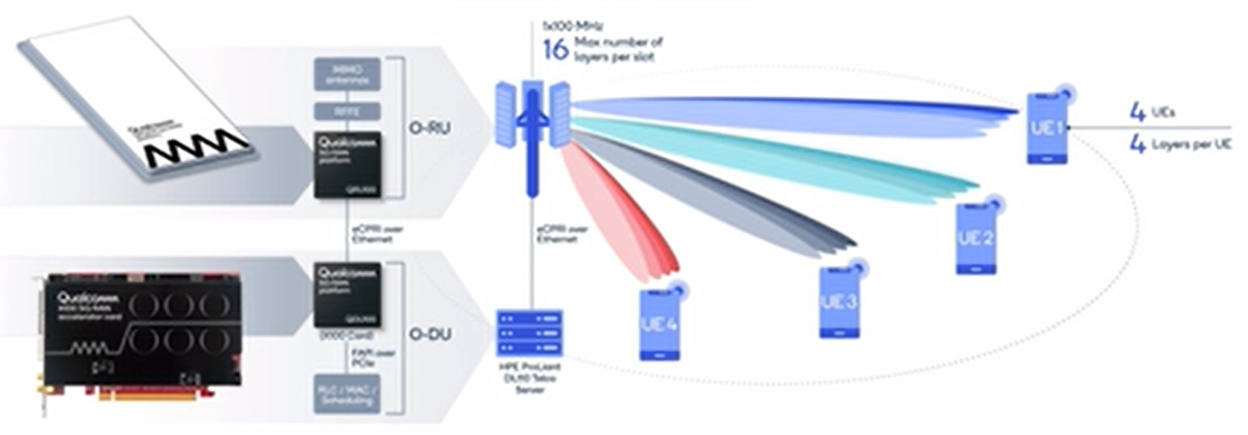

Slide 15
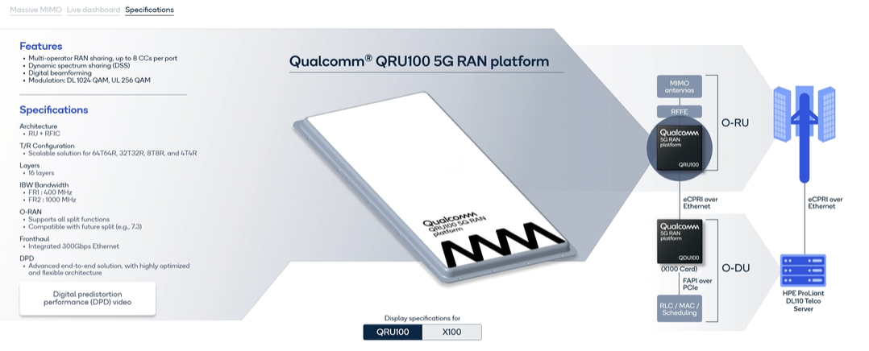

Slide 16
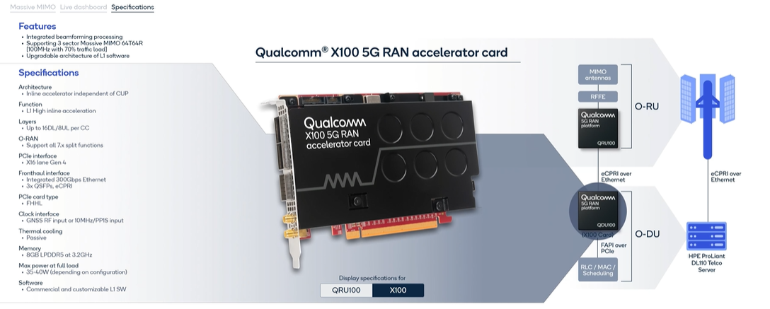

Slide 17

O_CU:-HPE ProLiant DL110 Gen10 Plus Telco server
Overview
Are you ready for 5G?
Customized for edge applications requiring high bandwidth and low latency such as 5G cellular processing (vRAN), the HPE ProLiant DL110 Gen10 Plus Telco server is based on open, standards-compliant infrastructure and offers dense I/O capabilities with PCIe Gen4 speed, acceleration, and powerful compute driven by 3rd Generation Intel® Xeon® Scalable Processors. The HPE ProLiant DL110 Gen10 Plus provides a reduced footprint with a compact, short-depth, 1U/1P front accessible chassis and ruggedized with NEBS Level 3 compliance for harsh environments. [1] Delivering the trusted HPE ProLiant experience with embedded HPE Integrated Lights-Out (iLO) management and security via HPE silicon root of trust, the HPE ProLiant DL110 Gen10 Plus is ready for communication service provider's 5G deployments

Slide 18
Outline of Presentation
5G TEST BED at IIIT KALYANI
DEMO 1 of 5G LAB SET UP AT IIIT KALYANI at ROOM NO G 05
https://drive.google.com/file/d/1mB3v7qXmhT4YCGtggj1umFyQipkE-LyN/view?usp=sharing
Discussion of 5G LAB SET UP AT IIIT KALYANI using 2X2 MIMO Spatial Multiplexed Radio Unit (RU)
SPEEDTEST using a 5G Mobile with POOR Throughput Efficiency due to use of Omni-directional
Antenna Beam ; Maximum Data rate =40 Mbps ( too Poor and Poor Throughput efficiency)
DEMO 2: Discussion on Recent DEMO 2 of 5G by QUALCOMM using MIMO Beamforming
Radio Unit (RU)
DEMO link: https://players.brightcove.net/1414329538001/BJv5wEFt_default/index.html?videoId=6322791358112
Throughput Efficiency =100% due to Laser like Antenna Beam
COMPARE 5G SYSTEM at IIIT KALYANI and QUALCOMM ; Note the difference in ANTENNA
DEMO 3: SYSTEMVUE Software Simulation of MIMO Beamforming Radio Unit (RU)
RADIATION PATTERN with 4X4 array and 32X32 ARRAY
TECHNOLOGY TRENDS towards 5G /6G Mobile Communication
5G UNIFIED and 5G SPLIT Architecture
5G UNIFIED Architecture : 5G NR ( New Radio) DL( Downlink) Throughput
DEMO 4: SISO Case using SYSTEMVUE Software Simulation
DEMO 5: SISO BF Case using SYSTEMVUE Software Simulation
DEMO 6: MIMO 2X2 Case MIMO 2x2 BF Case using SYSTEMVUE Software Simulation
5G SPLIT Architecture

Slide 19
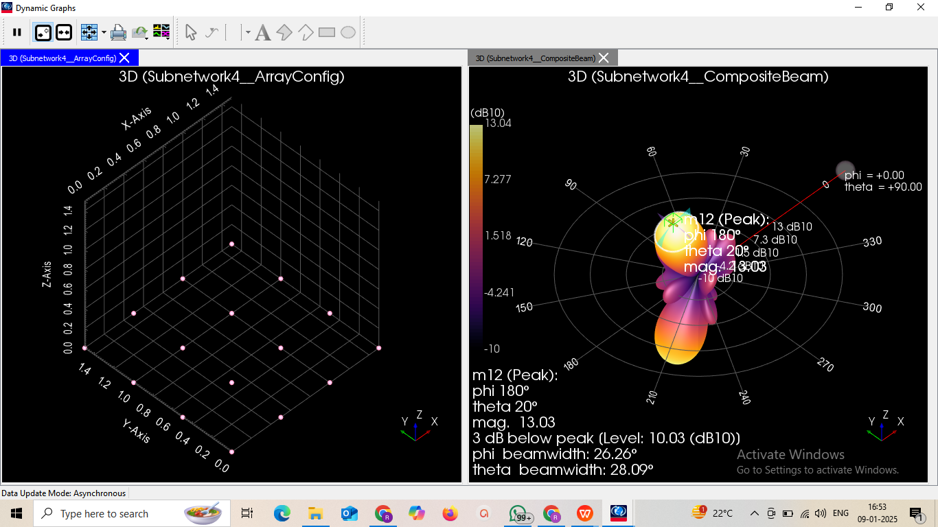
SYSTEMVUE Software Simulation of MIMO Beamforming Radio Unit (RU)
RADIATION PATTERN with 4X4 array [ ANTENNA Beamwidth = 26.26 Degree]

Slide 20
SYSTEMVUE Software Simulation of MIMO Beamforming Radio Unit (RU)
RADIATION PATTERN with 32X32 array [ ANTENNA Beamwidth = 3.112 Degree]
MIMO Beamforming Radio Unit (RU) RADIATION PATTERN with 32 no. of ARRAY ELEMENTS

Slide 21
Outline of Presentation
5G TEST BED at IIIT KALYANI
DEMO 1 of 5G LAB SET UP AT IIIT KALYANI at ROOM NO G 05
https://drive.google.com/file/d/1mB3v7qXmhT4YCGtggj1umFyQipkE-LyN/view?usp=sharing
Discussion of 5G LAB SET UP AT IIIT KALYANI using 2X2 MIMO Spatial Multiplexed Radio Unit (RU)
SPEEDTEST using a 5G Mobile with POOR Throughput Efficiency due to use of Omni-directional
Antenna Beam ; Maximum Data rate =40 Mbps ( too Poor and Poor Throughput efficiency)
DEMO 2: Discussion on Recent DEMO 2 of 5G by QUALCOMM using MIMO Beamforming
Radio Unit (RU)
DEMO link: https://players.brightcove.net/1414329538001/BJv5wEFt_default/index.html?videoId=6322791358112
Throughput Efficiency =100% due to Laser like Antenna Beam
COMPARE 5G SYSTEM at IIIT KALYANI and QUALCOMM ; Note the difference in ANTENNA
DEMO 3: SYSTEMVUE Software Simulation of MIMO Beamforming Radio Unit (RU)
RADIATION PATTERN
TECHNOLOGY TRENDS towards 5G /6G Mobile Communication
5G UNIFIED and 5G SPLIT Architecture
5G UNIFIED Architecture : 5G NR ( New Radio) DL( Downlink) Throughput
DEMO 4: SISO Case using SYSTEMVUE Software Simulation
DEMO 5: SISO BF Case using SYSTEMVUE Software Simulation
DEMO 6: MIMO 2X2 Case MIMO 2x2 BF Case using SYSTEMVUE Software Simulation
5G SPLIT Architecture

Slide 22
DEMO 4: 5G UNIFIED Architecture : 5G SISO Case SIMULATION using SYSTEMVUE Software

Slide 23
Outline of Presentation
5G TEST BED at IIIT KALYANI
DEMO 1 of 5G LAB SET UP AT IIIT KALYANI at ROOM NO G 05
https://drive.google.com/file/d/1mB3v7qXmhT4YCGtggj1umFyQipkE-LyN/view?usp=sharing
Discussion of 5G LAB SET UP AT IIIT KALYANI using 2X2 MIMO Spatial Multiplexed Radio Unit (RU)
SPEEDTEST using a 5G Mobile with POOR Throughput Efficiency due to use of Omni-directional
Antenna Beam ; Maximum Data rate =40 Mbps ( too Poor and Poor Throughput efficiency)
DEMO 2: Discussion on Recent DEMO 2 of 5G by QUALCOMM using MIMO Beamforming
Radio Unit (RU)
DEMO link: https://players.brightcove.net/1414329538001/BJv5wEFt_default/index.html?videoId=6322791358112
Throughput Efficiency =100% due to Laser like Antenna Beam
COMPARE 5G SYSTEM at IIIT KALYANI and QUALCOMM ; Note the difference in ANTENNA
DEMO 3: SYSTEMVUE Software Simulation of MIMO Beamforming Radio Unit (RU)
RADIATION PATTERN
TECHNOLOGY TRENDS towards 5G /6G Mobile Communication
5G UNIFIED and 5G SPLIT Architecture
5G UNIFIED Architecture : 5G NR ( New Radio) DL( Downlink) Throughput
DEMO 4: SISO Case using SYSTEMVUE Software Simulation
DEMO 5: SISO BF Case using SYSTEMVUE Software Simulation
DEMO 6: MIMO 2X2 Case MIMO 2x2 BF Case using SYSTEMVUE Software Simulation
5G SPLIT Architecture

Slide 24
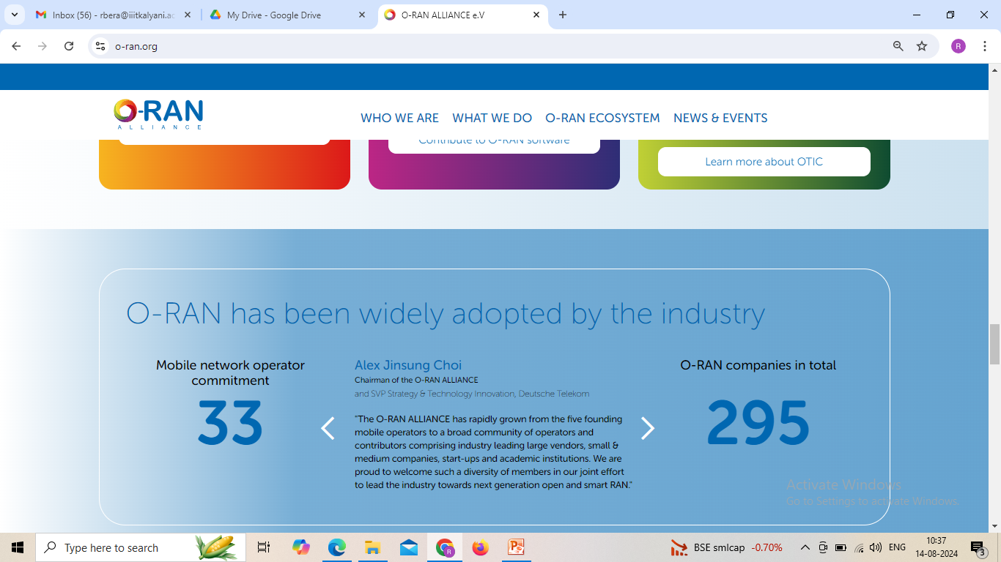

Slide 25
The Open RAN Objective

Slide 26
Realization Trends by QUALCOMM :
5G NR-RAN Evolution
NEWS Qualcomm and Vodafone Team for Next-gen 5G O-RAN Effort
November 04, 2022
Qualcomm and Vodafone recently announced that they will collaborate to test and develop infrastructure solutions that will be based on Qualcomm’s Open RAN (O-RAN) devices that are claimed to be energy efficient and high performing: the QRU100 5G RAN Platform, and the X100 5G RAN Accelerator Card. Qualcomm began sampling both cards in Q3 2022.
Vodafone is the leading telecommunications provider in Europe and has publicly committed to improving the environmental sustainability of its networks and brings expertise in large-scale network deployment to the partnership. The company envisions a future network that will support wireless high-bandwidth applications such as virtual and augmented reality.
The two companies plan to unveil more details on their 5G O-RAN infrastructure solution at the World Mobile Conference 2023 in Barcelona.
O_RAN = O_CU + O-DU + O-RU
O_CU:-
HPE ProLiant DL110
Gen10 Plus Telco server
O-DU Card within
PC
O_RU

Slide 27
Outline of Presentation
O-RAN (Nearest Base STATION near Your Mobile ACCESS) POPULARITY with
3.5 GHZ RADIO for 5G
O-RAN OBJECTIVES
Realization Trends by QUALCOMM … THE DEMO of O-RAN
Realization Trends by REBECA -LEKHA… INDIAN ATTEMPTS
Realization Trends by BTI Wireless
Realization Trends by VVDN Technologies… Indian Attempts [already with IIIT Kalyani (DOT FACILITIES ) ]
Realization from O-RAN to B-RAN for Network Wireless Security ; [B … BLOCKCHAIN ]
REALIZATION of O-RAN/B-RAN ARCHITECTURE at IIIT KALYANI with 5G USE CASE LAB SPONSORED BY DOT
Problem Definition, Assumption and Objectives of 5G/6G Research Works at IIIT, KALYANI
PICTORIAL REPRESENTATION of the OBJECTIVES OF IIIT, KALYANI
Deliverables from 5G/6G Research Works at IIIT, Kalyani
PICTORIAL REPRESENTATION of the HARDWARE DELIVERABLES
SOFTWARE SIMULATION DELIVERABLES
** https://players.brightcove.net/1414329538001/BJv5wEFt_default/index.html?videoId=6322791358112

Slide 32
O_CU:-HPE ProLiant DL110 Gen10 Plus Telco server
Overview
Are you ready for 5G?
Customized for edge applications requiring high bandwidth and low latency such as 5G cellular processing (vRAN), the HPE ProLiant DL110 Gen10 Plus Telco server is based on open, standards-compliant infrastructure and offers dense I/O capabilities with PCIe Gen4 speed, acceleration, and powerful compute driven by 3rd Generation Intel® Xeon® Scalable Processors. The HPE ProLiant DL110 Gen10 Plus provides a reduced footprint with a compact, short-depth, 1U/1P front accessible chassis and ruggedized with NEBS Level 3 compliance for harsh environments. [1] Delivering the trusted HPE ProLiant experience with embedded HPE Integrated Lights-Out (iLO) management and security via HPE silicon root of trust, the HPE ProLiant DL110 Gen10 Plus is ready for communication service provider's 5G deployments

